Slide 1

Stock Price Prediction Using Stock Transformer
Final Project Presentation
Presented by:
Zayan Rashid Rana
Muhammad Hammad Latif
Abdul Haseeb

Slide 2
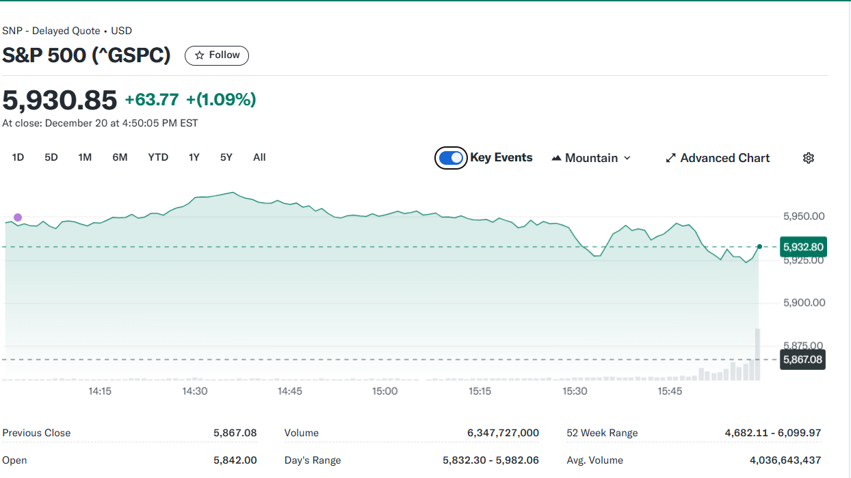
Problem Objectives and Details
Objective: Predict stock prices using state-of-the-art Transformer architecture.
Problem Statement:
Financial markets are highly dynamic and unpredictable.
Need for accurate, efficient, and scalable prediction models.
Traditional models struggle with complex temporal dependencies.

Slide 3
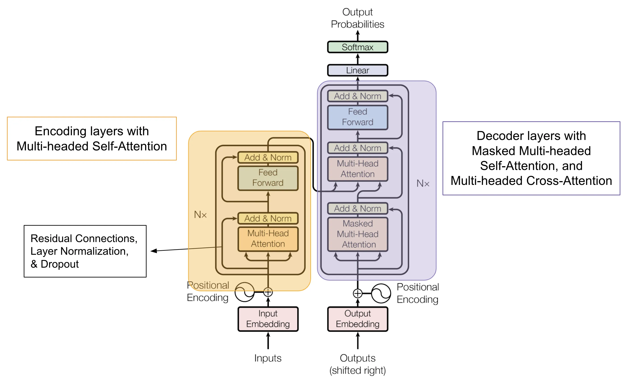
Transformer Architectural Details
Key Features:
Encoder-decoder structure (or customized for time-series data).
Attention mechanism for capturing dependencies.
Parallelism for faster training.

Slide 4
Layers
Transformer Model Architecture for Stock Prediction:
1. Input Layer:
Input shape: (lookback, features) (similar to LSTM).
2. Positional Encoding:
Since transformers don't have recurrence, positional encoding is added to encode sequence information.
3. Transformer Encoder Layers:
Number of layers: 2–4 (depending on complexity).
Attention heads: Typically 4–8 for stock data. (We used 4)
Hidden dimension: 64–128.
Feedforward layers with dropout.
4. Dense Layers:
Dense Layer 1: Units = 64 (or reduce dimensionality).
Dense Layer 2: Units = 1 (output layer for regression).

Slide 5
Key Parameters
Lookback Period: 60 (number of previous time steps used as input)
Test Size: 0.2 (20% of the data is used for testing)
Batch Size: 32 (number of samples per gradient update)
Epochs: 200 (number of times the model is trained on the entire dataset)
Learning Rate: 0.001 (learning rate for the Adam optimizer)
Dropout Rate: 0.2 (20% of the neurons will be dropped to prevent overfitting)

Slide 6
Training Details
Loss Function: Mean Squared Error (MSE) / Custom loss function.
Training Configuration:
Epochs: 200 (followed with an early stopping).
Time per Epoch: approx. 3 secs
Batch Size: 32
Learning Rate: 0.001.

Slide 7
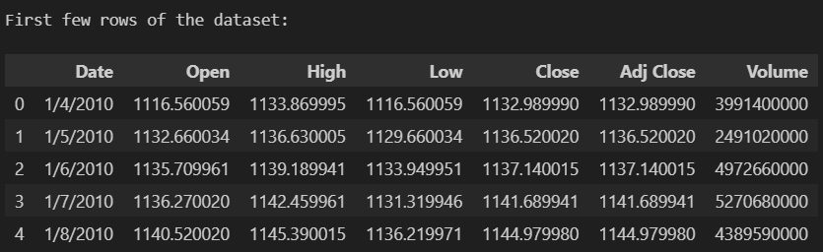
Experiments
Dataset: Fetched from yahoo finance and saved as .csv file
Experiment Details:
Train-test split ratio.
Data preprocessing techniques.
Performance evaluation metrics: MAE, RMSE, R².

Slide 8
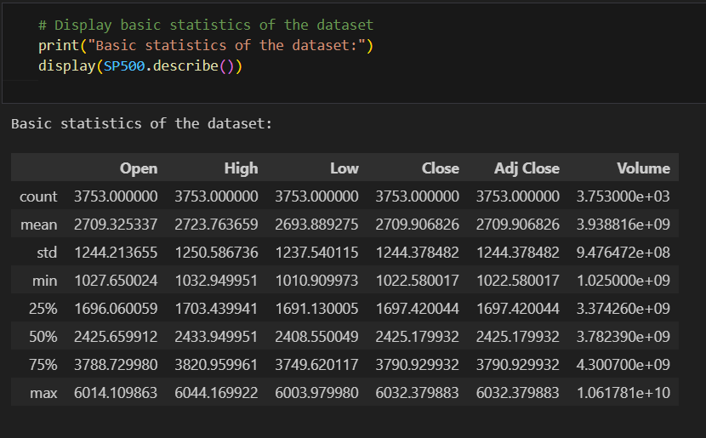
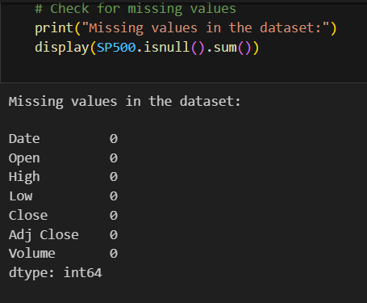
Pre-processing

Slide 9
Exploration

Slide 10
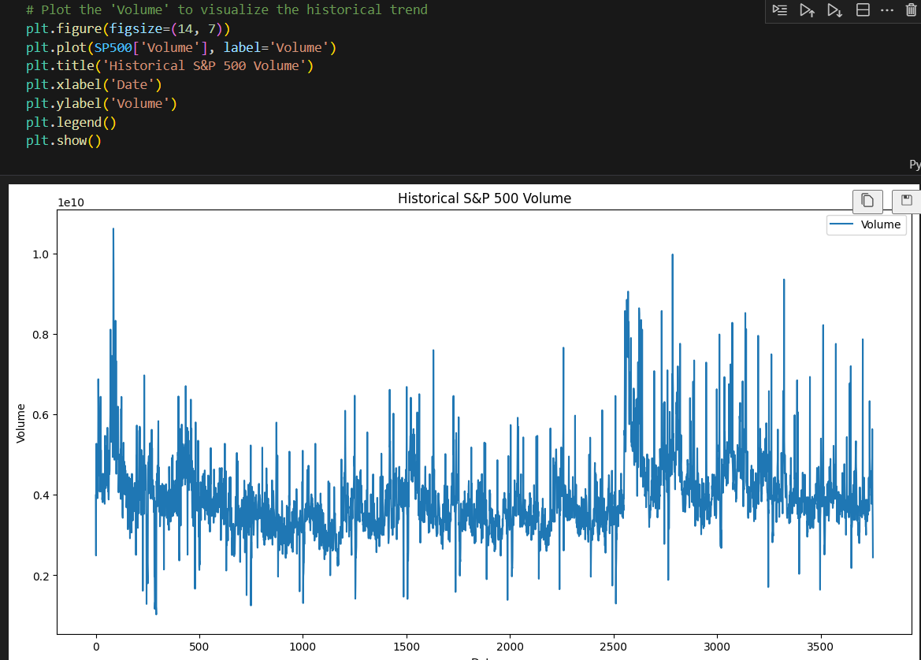
Plot the 'Volume' to visualize the historical trend

Slide 11
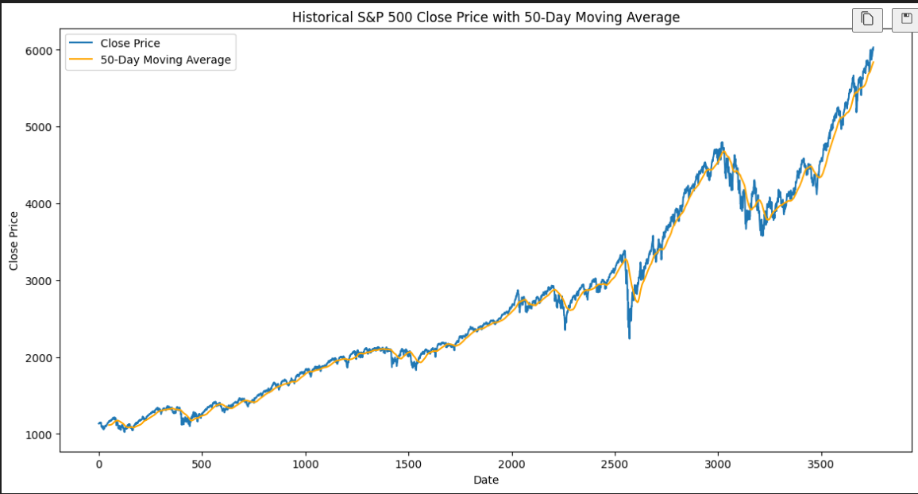
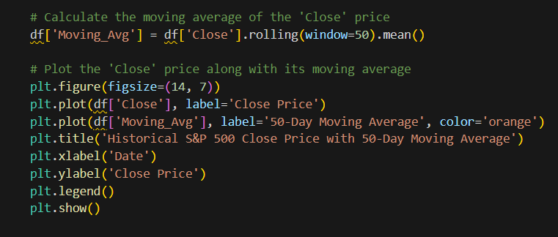
Calculate the moving average of the 'Close' price

Slide 12
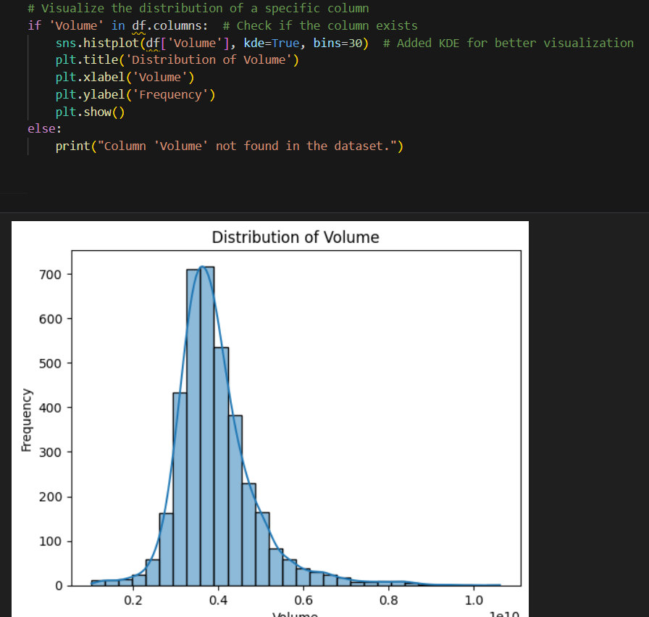
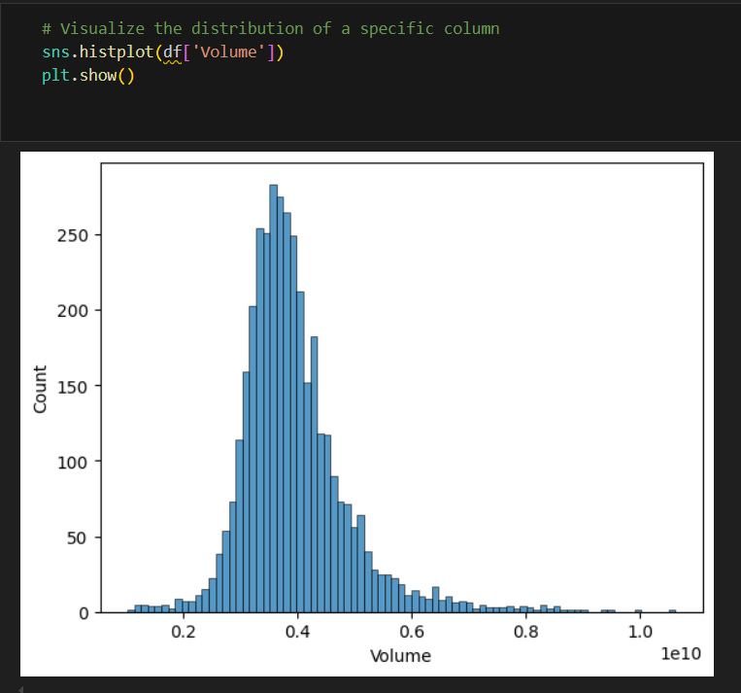
Simple and comparative Visualization

Slide 13
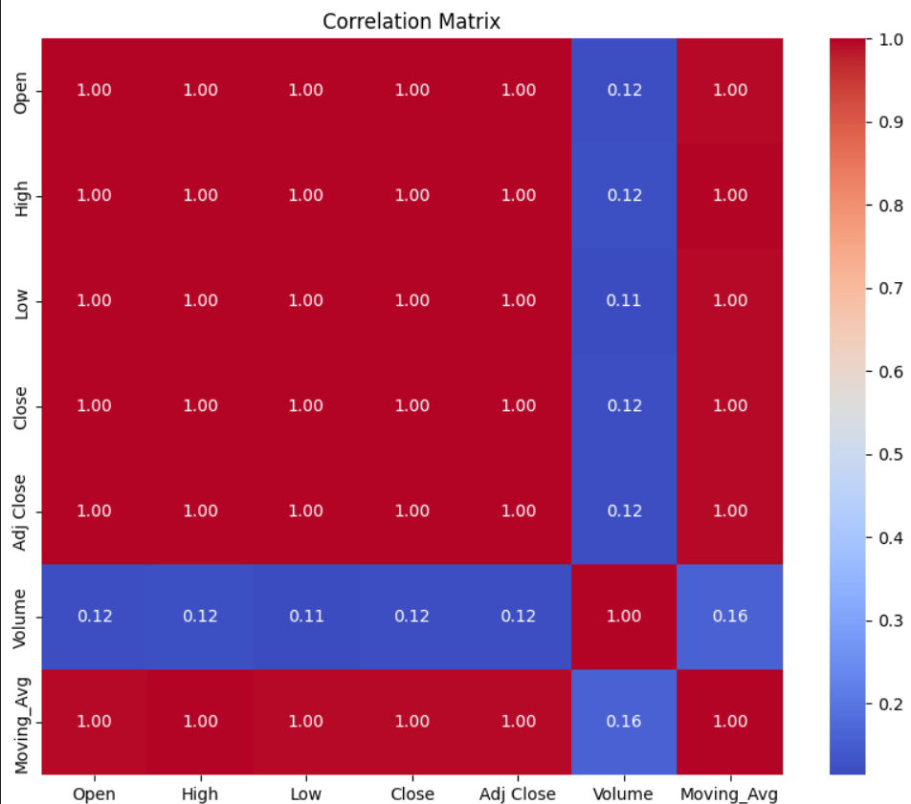
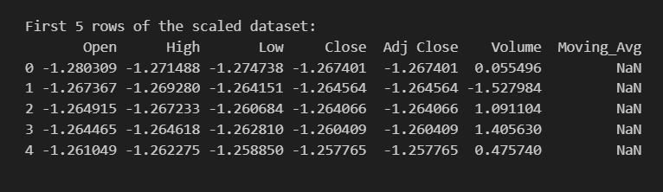
Correlation Matrix (Volume is independent)

Slide 14
RESULTS

Slide 15
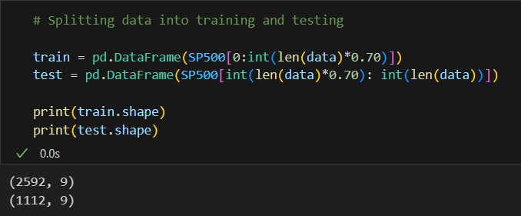
RESULTS

Slide 16
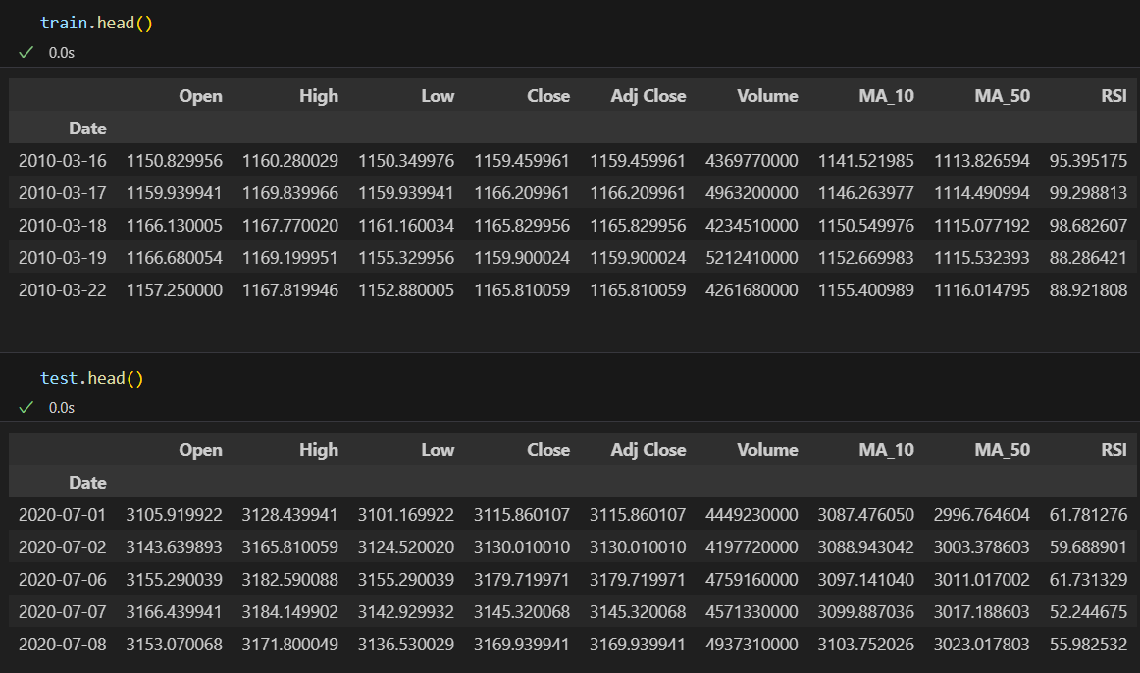
RESULTS

Slide 17
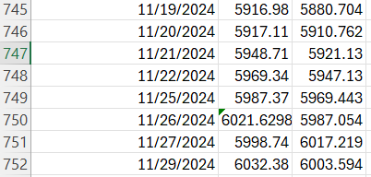
Actual vs Predicted close price values

Slide 18
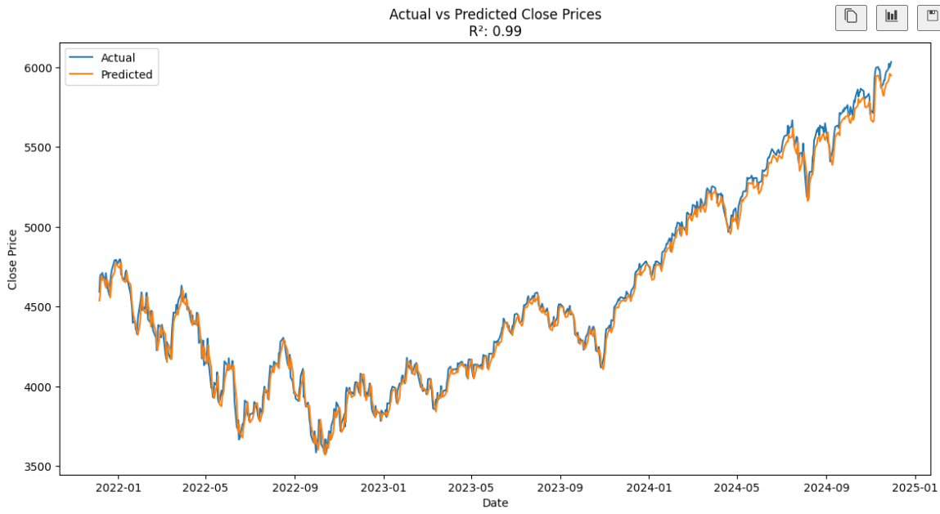
Actual vs Predicted

Slide 19
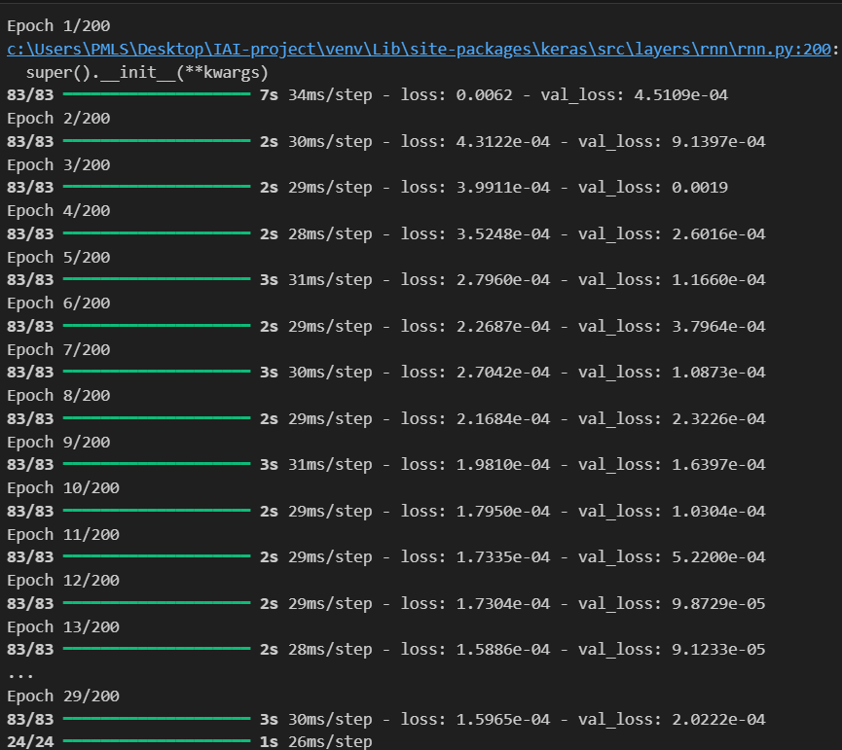
Implementation of early stopping
Prevented overfitting

Slide 20
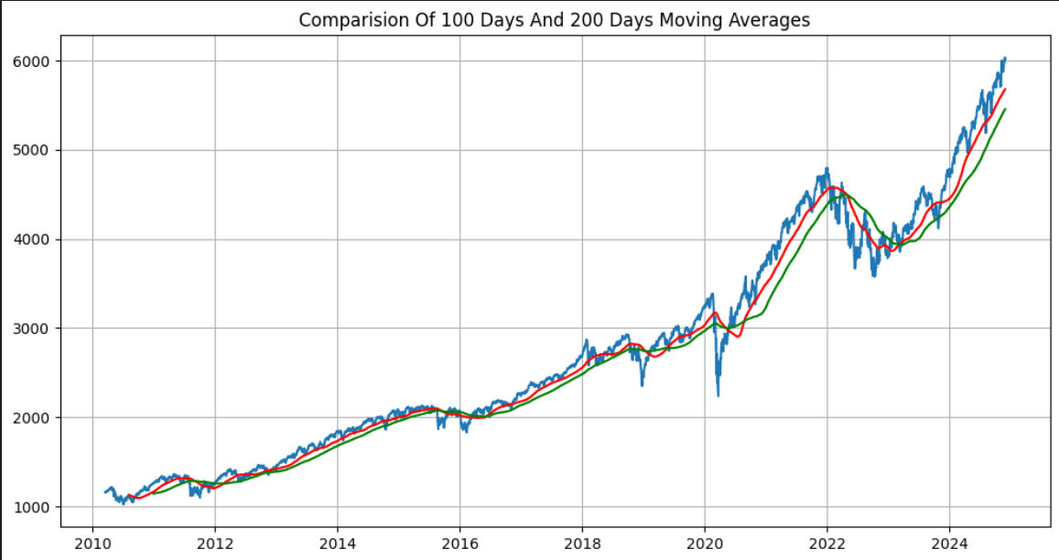
Comparison Of 100 Days And 200 Days Moving Averages

Slide 21
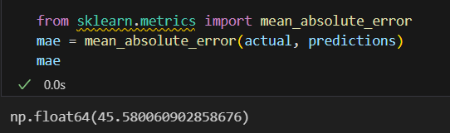
The Mean Absolute Error (MAE) expressed as a percentage is 6.99%, which indicates that the model's average prediction error is about 4.5% of the mean actual value in the test set.
MAE
Less than 10%

Slide 22
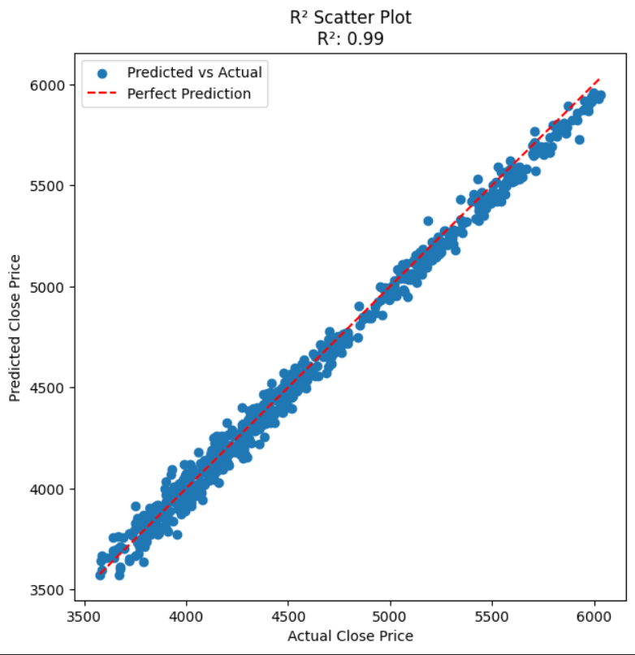
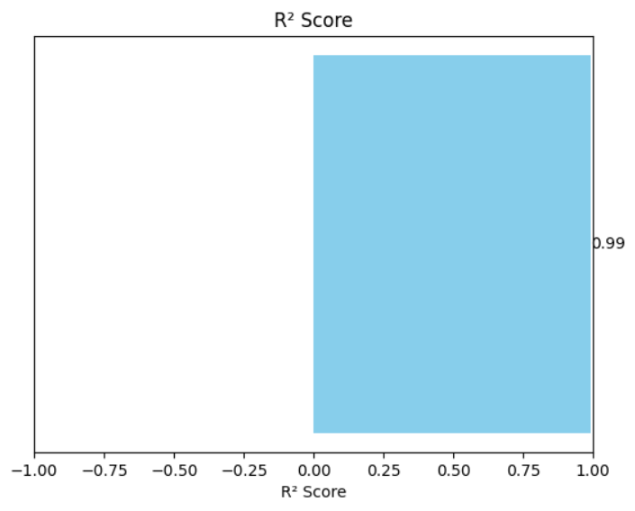
Calculation of R2 score

Slide 23
Combining the R² value of 0.99 and the MAE of 4.5%, the model appears to perform well, with accurate predictions and a strong fit to the data.

Slide 24
Business Intelligence Analysis

Slide 25
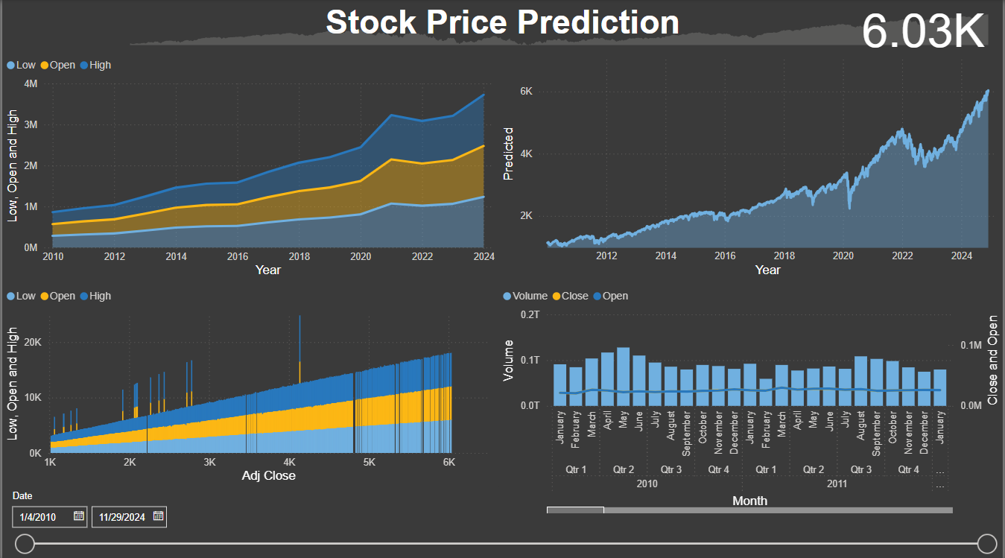

Slide 26
Demonstration

Slide 27
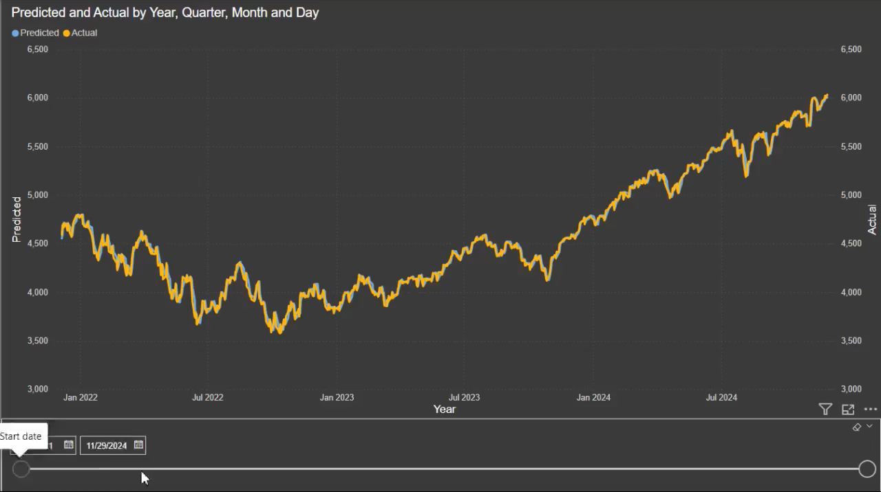

Slide 28
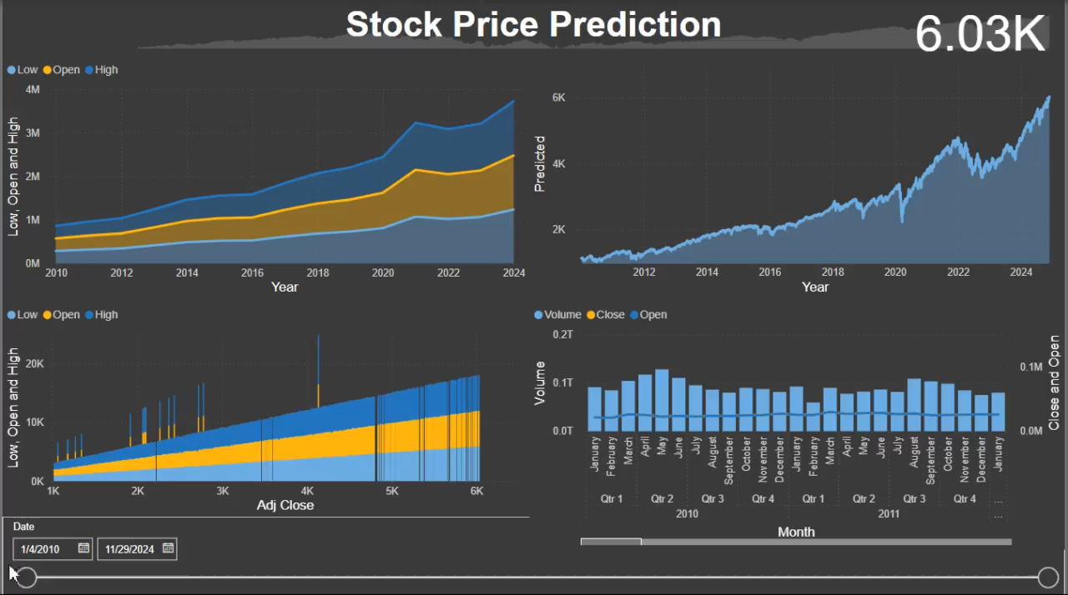

Slide 29
Conclusion
Summary:
Transformer model effectively captures temporal dependencies.
Promising results for real-world applications.
Future Work:
Explore more sophisticated Transformer variants (e.g., Time-Series Transformer).
Incorporate external factors (news, social sentiment).

Slide 30
Thank you for your attention!

